Slide 1
Universal Serial Bus 3.0

Slide 2
Introduction
Released in November 2008
10 times faster than USB 2.0

Slide 3
Features
Speed : 5 Gigabits/second
Full duplex data transfer
Backward USB 2.0 compaitable
Maximum current : 900 mA
No polling and broadcasting

Slide 4
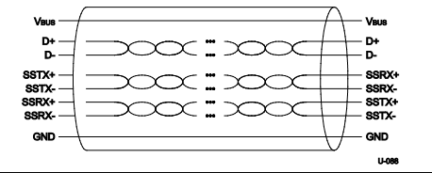
USB 3.0 Cable

Slide 5
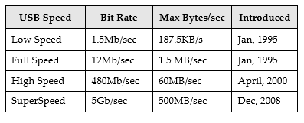
Speed Comparison

Slide 6
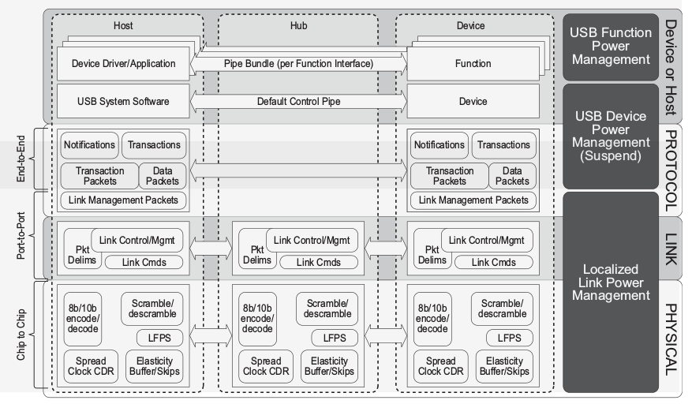
USB 3.0 Architecture

Slide 7
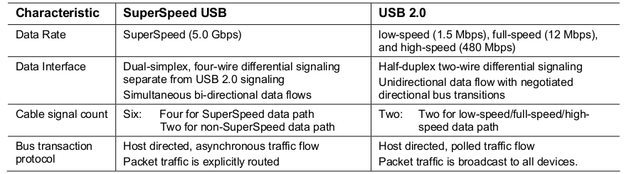
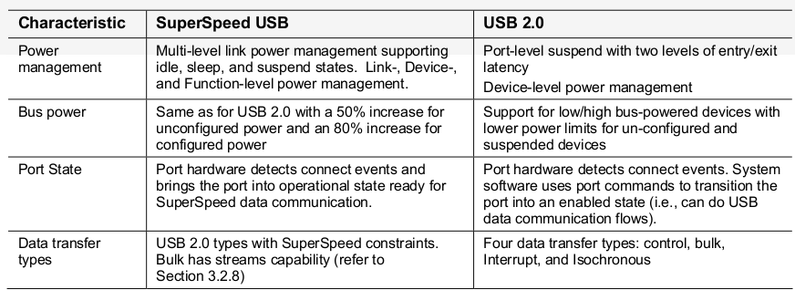
Difference between USB 2.0 & 3.0

Slide 8
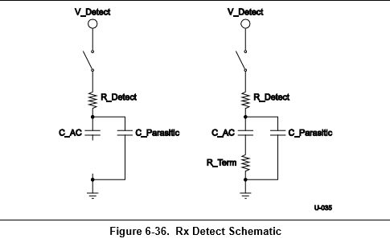
SuperSpeed Device Detection

Slide 9
Device Enumeration
Rx detect tells if the device is Super speed
Device gets reset
Device will be in default state and draws power no more tha 150 mA
Host assigns unique address to device
Reads descriptor to find the maximum payload size and to learn about the device
Loads the specific driver to start commmunication

Slide 10
Layers in USB 3.0
Physical Layer
Link Layer
Protocol Layer

Slide 11
Link Layer
Error Checking using CRC
Sequence Numbering
Packets Framing
Link commands (verify successful transmission)
Ordered sets for synchronization

Slide 12
Protocol Layer
End to end communication
Defines set of rules for communication

Slide 13
Packets
Transaction packet
Data packet
Link management packet
Isochronous time stamp packet

Slide 14
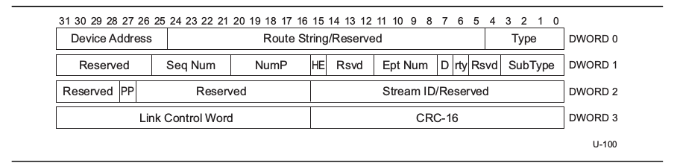
Transaction packet

Slide 15
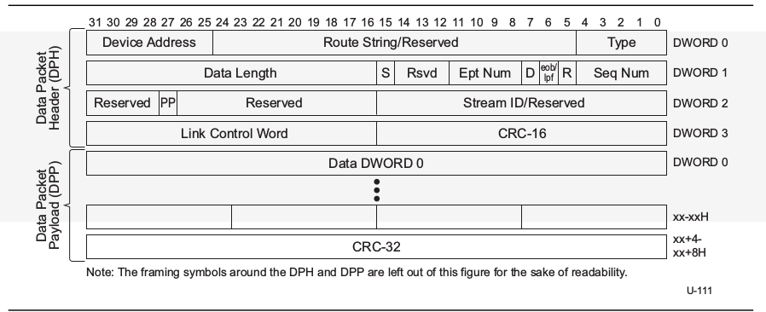
Data Packet

Slide 16
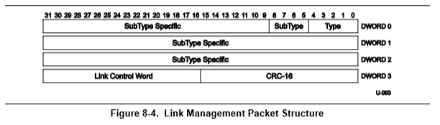
Link Management packet

Slide 17
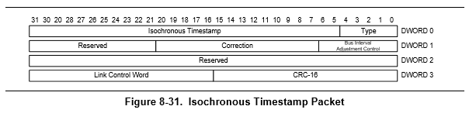
Isochronous Timestamp packet

Slide 18
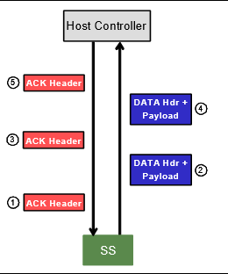
IN Transaction protocol

Slide 19
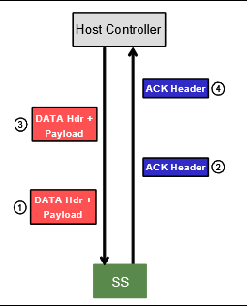
Out Transaction protocol

Slide 20
Transfer types
Control transfer
Bulk transfer
Interrupt transfer
Isochronous transfer

Slide 21
Control transfer
Host uses control transfer to get information about the device
20 percentage of banwidth is allocated to control transfer
Maximum data packet size : 512 bytes

Slide 22
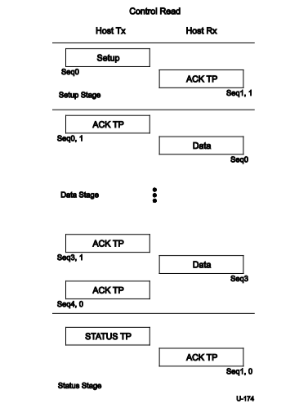

Slide 23
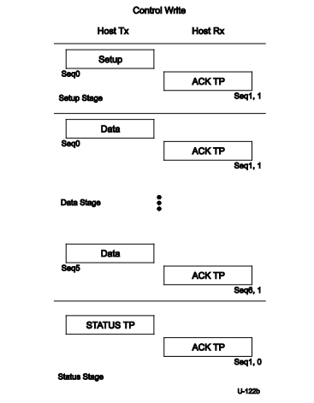

Slide 24
Bulk transfer
Bulk transfer is used to transmit large amount of data
Bulk transfer uses 20 percentage of bus bandwidth
Maximum data packet size : 1024 bytes

Slide 25
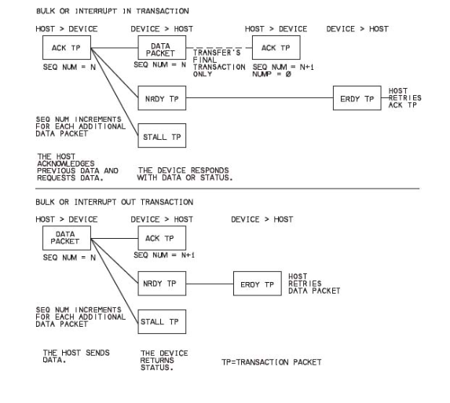

Slide 26
Interrupt transfer
Interrupt transfer are used to get the status update from a device
Interrupt and isochronous transfer can combinely use 90 percentage of bandwidth
Maximum data packet size : 1024 bytes

Slide 27
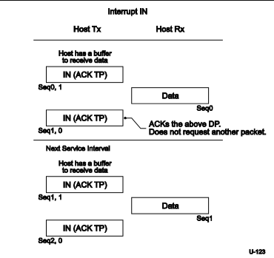

Slide 28
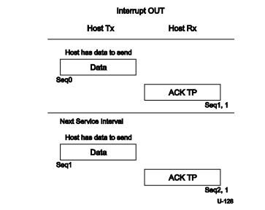

Slide 29
Isochronous transfer
Isochronous transfer are used in transferring real time data
Interrupt and isochronous transfer can combinely use 90 percentage of bandwidth
Maximum data packet size : 1024 bytes

Slide 30
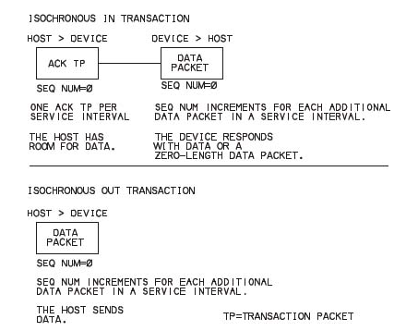

Slide 31
USB descriptors
Device descriptor
Configuration descriptor
Interface descriptor
Endpoint descriptor
BOS descriptor
Capability descriptor

